Slide 1
UTS Implementation Guideline
for DCV WAVE
Author: minh1.nguyen
UNIT TEST

Slide 2
Table of Contents
Build Unit Test Environment
Create Test Script for your project
Build Test Script

Slide 3
1. Build Unit Test Environment
A UTS Environment Setup guide was created by Mr. Dat.Vu. Please refer to below guideline document.

Slide 4
2. Create Test Script
Introduction
This section will show how to create Unit Test code automatically based on your application’s source code. There are some situations the tool can not create test cases completely, so you must add more test cases to cover all your source code.
Precondition
Unit Test Environment
Application source code. (In this guideline, Remote Service application’s source code is used as a example)

Slide 5
2. Create Test Script
Download tool and script file
1. Put your source code in this path, see below:
/home/minh1nguyen/fsl-release-bsp/build-bmwwave/tmp/work/aarch64-poky-linux/RemoteServiceApplication
Note:
“RemoteServiceApplication” is your source code folder.
“fsl-release-bsp” is the folder is created after the UTS environment is built.
2. Download “findmethod” binary and “vc_ut.py” script file. Please replace “14.04” by “16.04” if your Ubuntu version is 16.04.
##### Download findmethod binary and vc_ut.py script file ## Please replace “14.04” by “16.04” if your Ubuntu version is 16.04. ❯ wget http://swta.lge.com/uts/bmwwave-guide/bin/14.04/findmethod ❯ wget http://swta.lge.com/uts/bmwwave-guide/scripts/vc_ut.py ❯ chmod +x findmethod vc_ut.py

Slide 6
2. Create Test Script
Create build_config.json and perform tool
UTS parses the source based on “build_config.json”, and automatically generates Test Script and CMakeLists.txt. To create build_config.json, you can create a default template using vc_ut.py, In addition, you must fill the required information to build.
##### Run script(vc_ut.py) ## working direcotry is in coding_client ❯ ./vc_ut.py --c_build_config

Slide 7
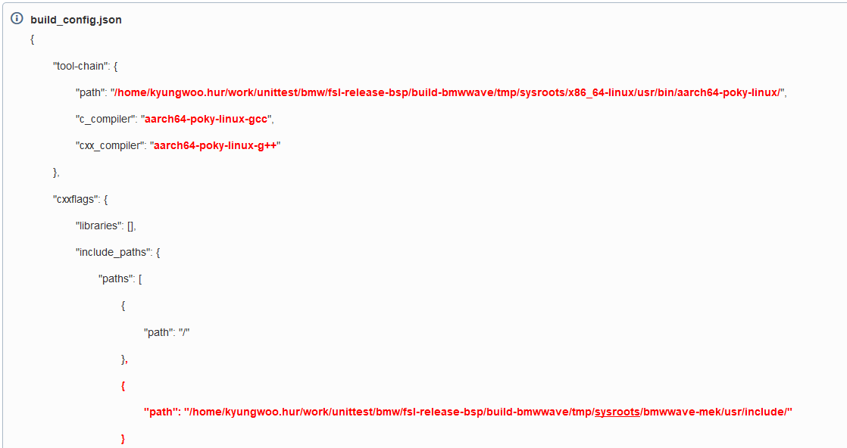
2. Create Test Script
Modify build_config.json
The default build_config.json is shown below.
Add and modify the tool-chain path and cxxflags, include_paths, and sysroot you need to modify for the build here. You may have to add more include paths if errors occur.
(The place marked in red is modified, and it needs to be modified according to your PATH.)

Slide 8
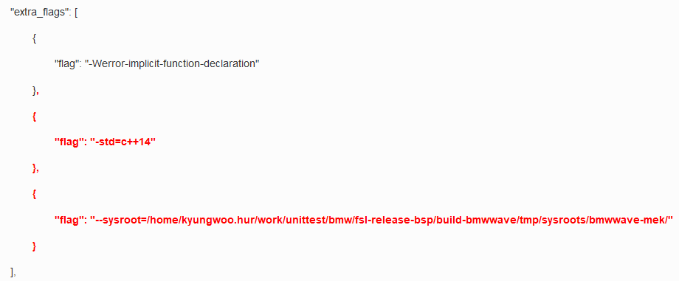
2. Create Test Script
Modify build_config.json
Please compare 2 files below to find out the differences between them.

Slide 9
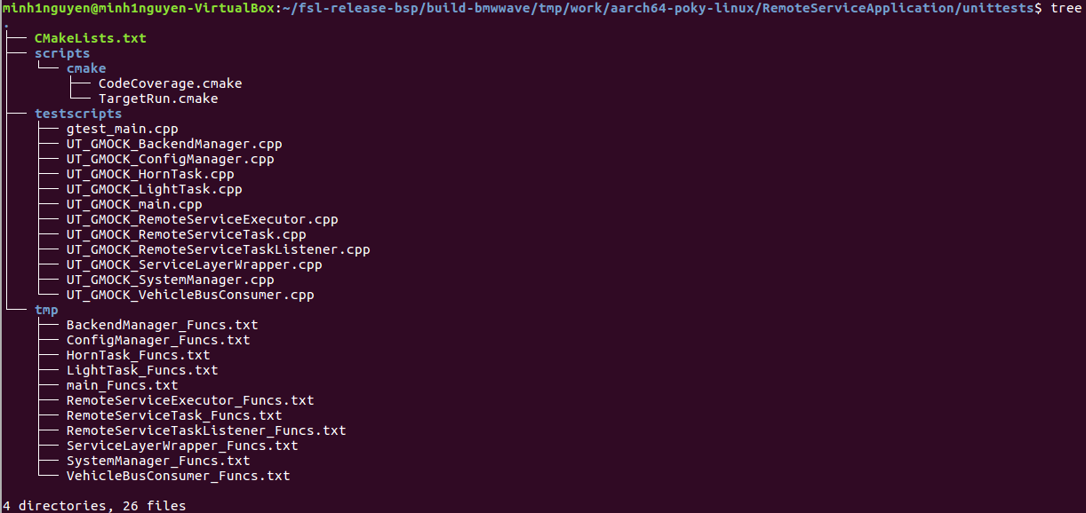
2. Create Test Script
Generate a test script
After modifying build_config.json, use the vc_ut.py script to analyze the source and generate a test script.
(As for Remote service source code, you must run command “./build.sh” before running above command, a header file is generated and it is used for above command )
When the script finishes working, a directory called “unittests” is created
❯ ./vc_ut.py --all --enable_tc

Slide 10
3. Build Test Script
Run Commands
Run these commands below:
In step “make –j8”, there are some errors. Please fix them step by step, see below:
Error 1:
Fix solution: replace “cha” by “char” in line 130, file “UT_GMOCK_VehicleBusConsumer.cpp”
##### Build test script ##### working direcotry is in unittests/build ## Build directory and build and build environment with cmake ❯ cd unittests ❯ mkdir build ❯ cd build ❯ cmake .. ❯ make -j8

Slide 11
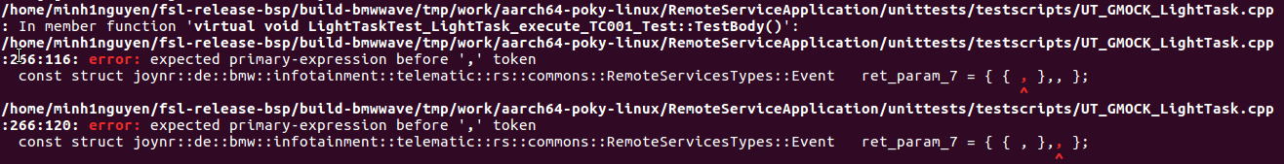
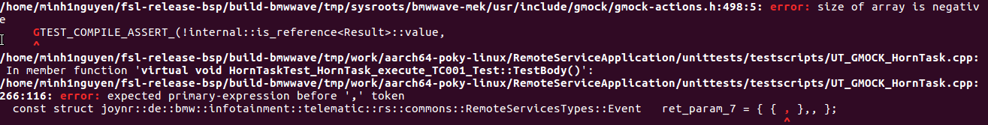
3. Build Test Script
Resolve Errors
Error 2:
Fix solution:
- Comment out 2 lines: Line 266 and line 269 in file “UT_GMOCK_LightTask.cpp”
Error 3:
Fix solution:
- Comment out 2 lines: Line 266 and line 269 in file “UT_GMOCK_HornTask.cpp”

Slide 12
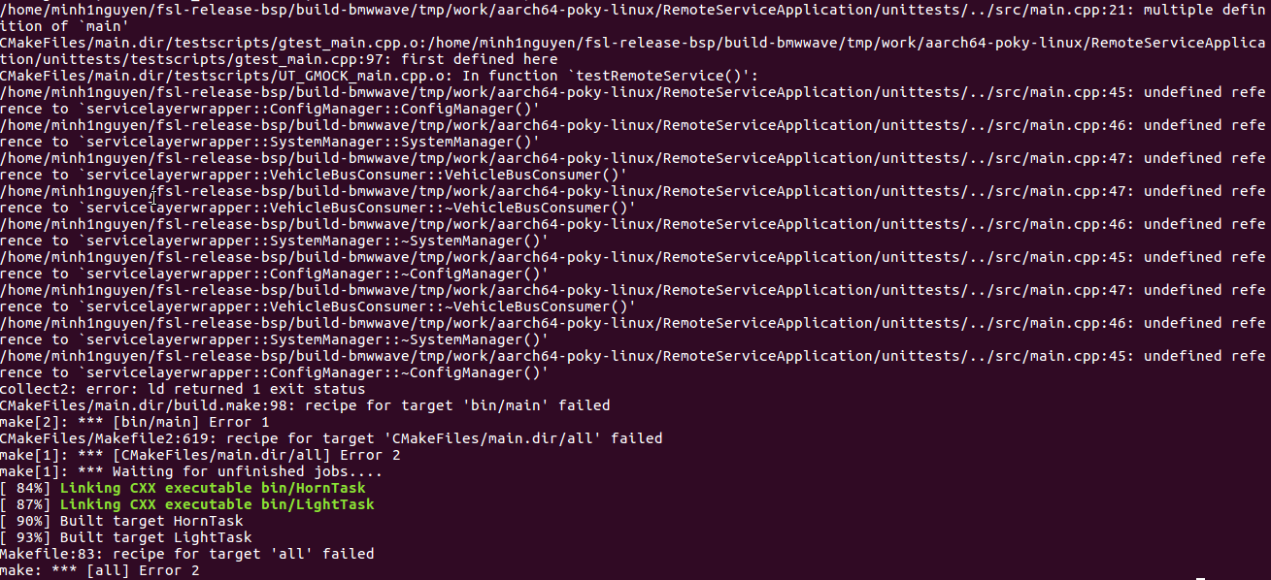
3. Build Test Script
Resolve Errors
Error 4:
Fix solution:
Comment out lines: 380, 417, 448 file “UT_GMOCK_main.cpp”.
Wrap the “main” function in file “/RemoteServiceApplication/src/main.cpp” by below statement:
#ifndef __UT_BUILD__ // main function #endif

Slide 13
3. Build Test Script
After Fixing Errors
After all errors are fixed, run this command again:
❯ make -j8

Slide 14
4. Run Test Script
Download Script
Download script for test measurement and test coverage.
Run Script
❯ wget http://swta.lge.com/uts/bmwwave-guide/scripts/run-coverage_arm.sh ❯ chmod +x run-coverage_arm.sh
❯ ./run-coverage_arm.sh

Slide 15
4. Run Test Script
Resolve bugs
There are some errors when run test scripts (the cause can not be detected yet, let me investigate this issue then I will let you know in further updated versions)
Disable the following test cases by change “#if 1” to “#if 0” to skip the errors:
TEST_F(LightTaskTest, LightTask_execute_TC001) → file /unittests/testscripts/UT_GMOCK_LightTask.cpp
TEST_F(HornTaskTest, HornTask_execute_TC001) → file /unittests/testscripts/UT_GMOCK_HornTask.cpp
TEST_F(RemoteServiceExecutorTest, RemoteServiceExecutor_start_TC001)
File /unittests/testscripts/UT_GMOCK_RemoteServiceExecutor.cpp
TEST_F(RemoteServiceTaskListenerTest, RemoteServiceTaskListener_remoteFlashLight_TC001)
TEST_F(RemoteServiceTaskListenerTest, RemoteServiceTaskListener_remoteBlowHorn_TC001)
→ File /unittests/testscripts/UT_GMOCK_RemoteServiceTaskListener.cpp

Slide 16
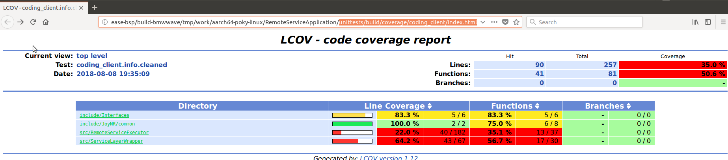
4. Run Test Script
Check Test Report
After running test script successfully, refer to the test report “/unittests/build/coverage/coding_client/index.html”

